Slide 1
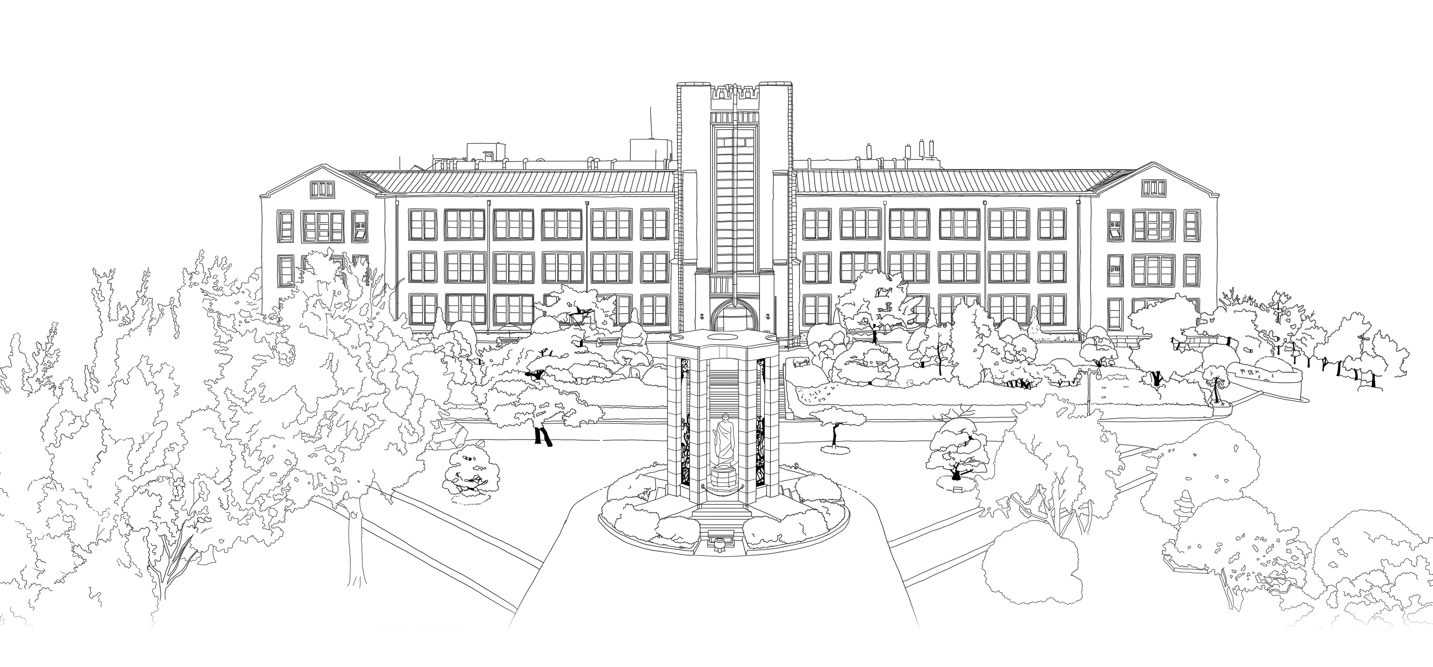


Introduction to Algorithms
DongYeon Kim
Department of Multimedia Engineering
Dongguk University

Slide 2
Contents
Chapter.1 Foundations
‘
;
0
Divide-and-Conquer
The maximum-subarray problem
Strassen’s algorithm for matrix multiplication
The substitution method for solving recurrences
The recursion-tree method for solving recurrences
Proof of the master theorem
Probabilistic Analysis and Randomized Algorithms
The hiring problem
Indicator random variables
Randomized algorithms
Probabilistic analysis and further uses of indicator random variables
The Role of Algorithms in Computing
Algorithms
Algorithms as a technology
Getting Started
Insertion sort
Analyzing algorithms
Designing algorithms
Growth of Functions
Asymptotic notation
Standard notations and common functions
Notes:
모든 Feature마다 이상치를 제거하게 되면 너무 많은 데이터 손실이 발생

Slide 3
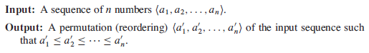
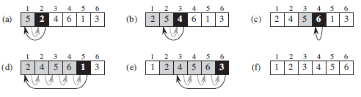
Getting Started
Insertion Sort
How does it work?
Notes:
모든 Feature마다 이상치를 제거하게 되면 너무 많은 데이터 손실이 발생

Slide 4
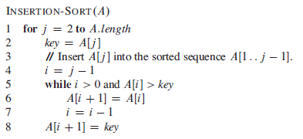
Getting Started
Insertion Sort
Pseudocode
Line 1~2: initialize Key value
Line 5: compare Key value with shaded rectangle values
Line 6~7: move shaded rectangles one position to the right
Line 8: insert key value
Notes:
모든 Feature마다 이상치를 제거하게 되면 너무 많은 데이터 손실이 발생

Slide 5
Getting Started
Insertion Sort
Loop Invariant
Definition : Loop Invariant is a property of a program loop that is true before each iteration
Property
Initialization : It is true prior to the first iteration of the loop.
Maintenance : If it is true before an iteration of the loop, it remains true before the next iteration
Termination : When the loop terminates, the invariant gives us a useful property that helps show that the algorithm is correct
Similarity to mathematical induction
Notes:
모든 Feature마다 이상치를 제거하게 되면 너무 많은 데이터 손실이 발생

Slide 6
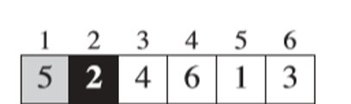
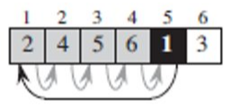
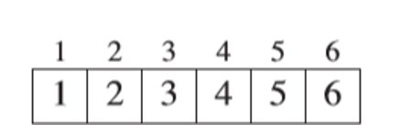
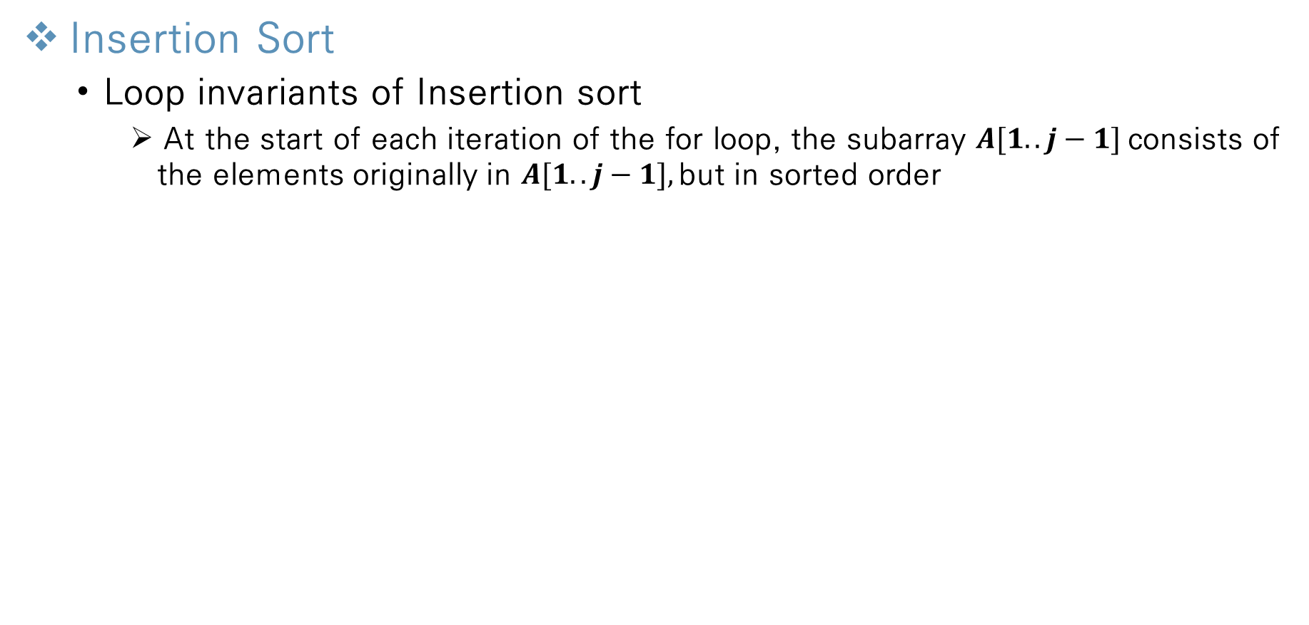
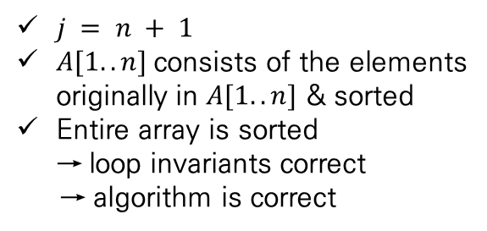
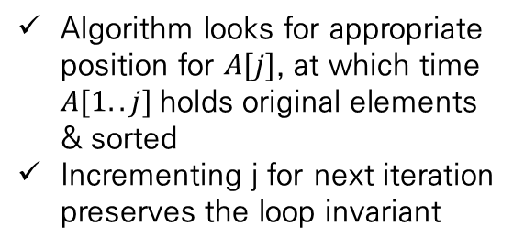
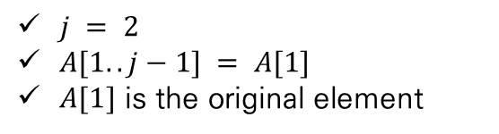
Getting Started
Insertion Sort
Loop invariants of Insertion sort
At the start of each iteration of the for loop, the subarray $A[1..j−1]$consists of the elements originally in $A[1..j−1],$but in sorted order
Initialization
Maintenance
Termination
$j = 2$
$A[1..j−1] = A[1]$
$A[1]$ is the original element
Algorithm looks for appropriate position for $A[j]$, at which time $A[1..j]$holds original elements & sorted
Incrementing j for next iteration preserves the loop invariant
$j = n + 1$
$A[1..n]$consists of the elements originally in $A[1..n]$ & sorted
Entire array is sorted
→ loop invariants correct
→ algorithm is correct
Notes:
모든 Feature마다 이상치를 제거하게 되면 너무 많은 데이터 손실이 발생

Slide 7
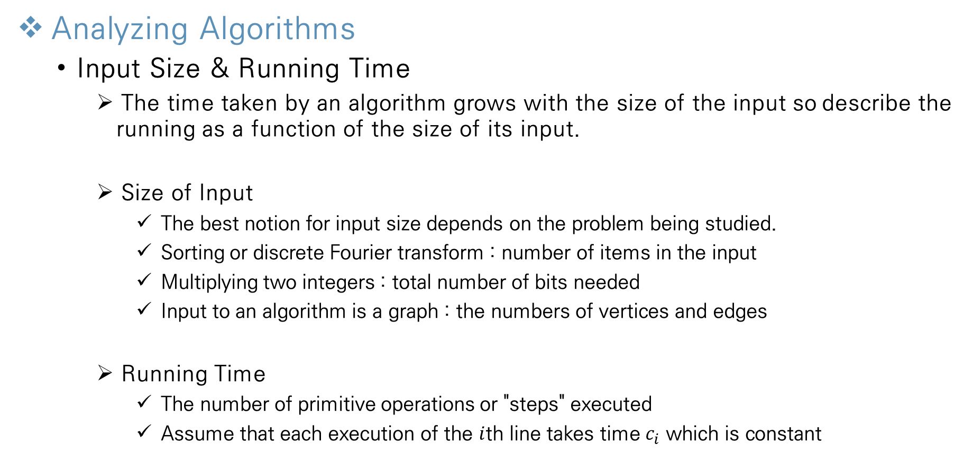
Getting Started
Analyzing Algorithms
Input Size & Running Time
The time taken by an algorithm grows with the size of the input so describe the running as a function of the size of its input.
Size of Input
The best notion for input size depends on the problem being studied.
Sorting or discrete Fourier transform : number of items in the input
Multiplying two integers : total number of bits needed
Input to an algorithm is a graph : the numbers of vertices and edges
Running Time
The number of primitive operations or "steps" executed
Assume that each execution of the $i$th line takes time $c_{i}$ which is constant
Notes:
모든 Feature마다 이상치를 제거하게 되면 너무 많은 데이터 손실이 발생

Slide 8
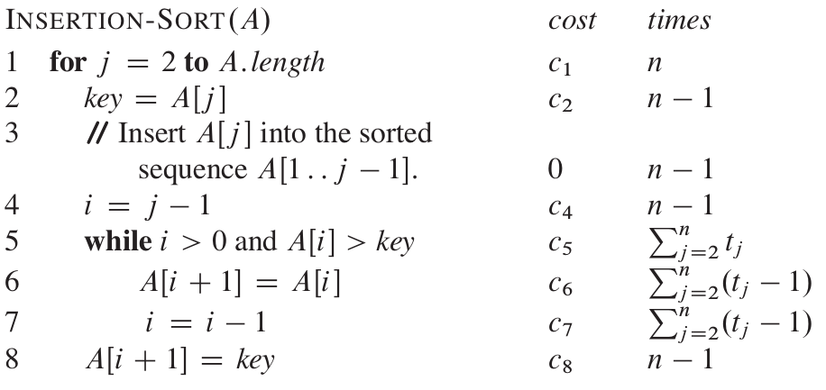
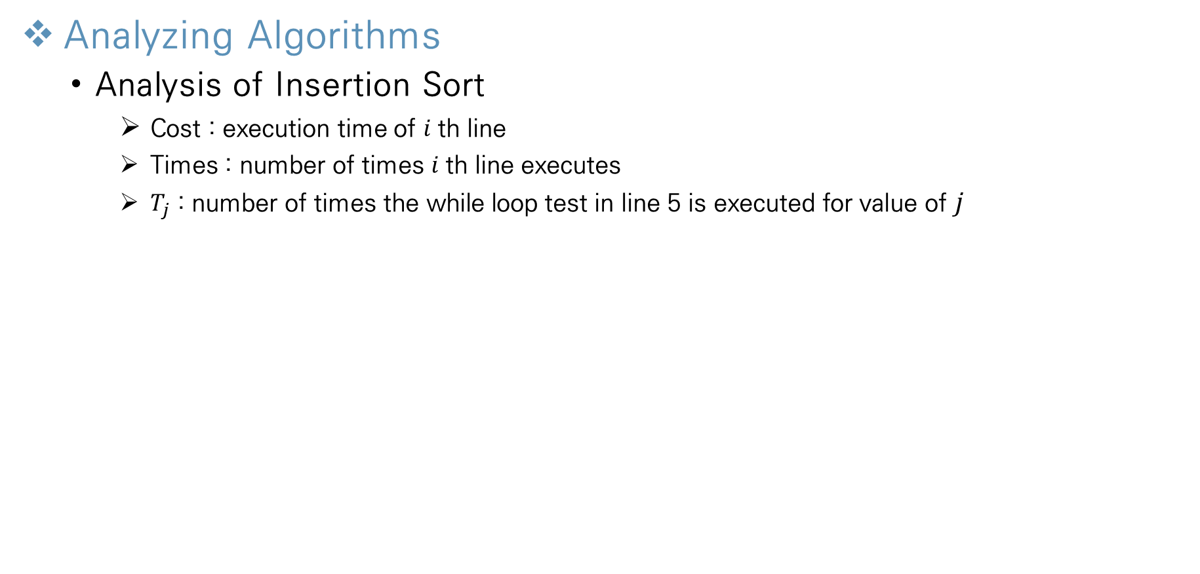
Getting Started
Analyzing Algorithms
Analysis of Insertion Sort
Cost : execution time of $i$th line
Times : number of times $i$th line executes
$T_{j}$ : number of times the while loop test in line 5 is executed for value of $j$
Notes:
모든 Feature마다 이상치를 제거하게 되면 너무 많은 데이터 손실이 발생

Slide 9
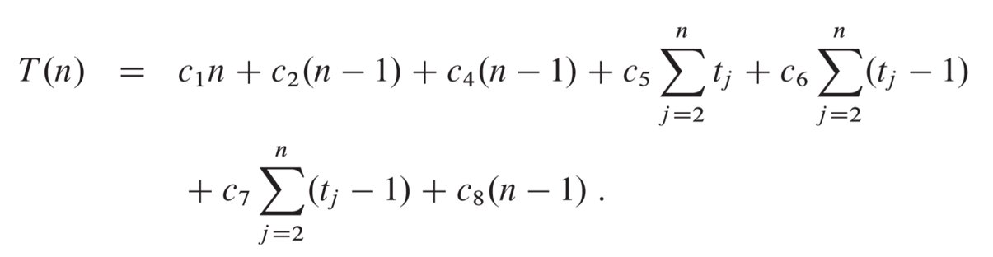
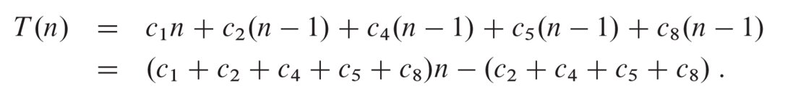
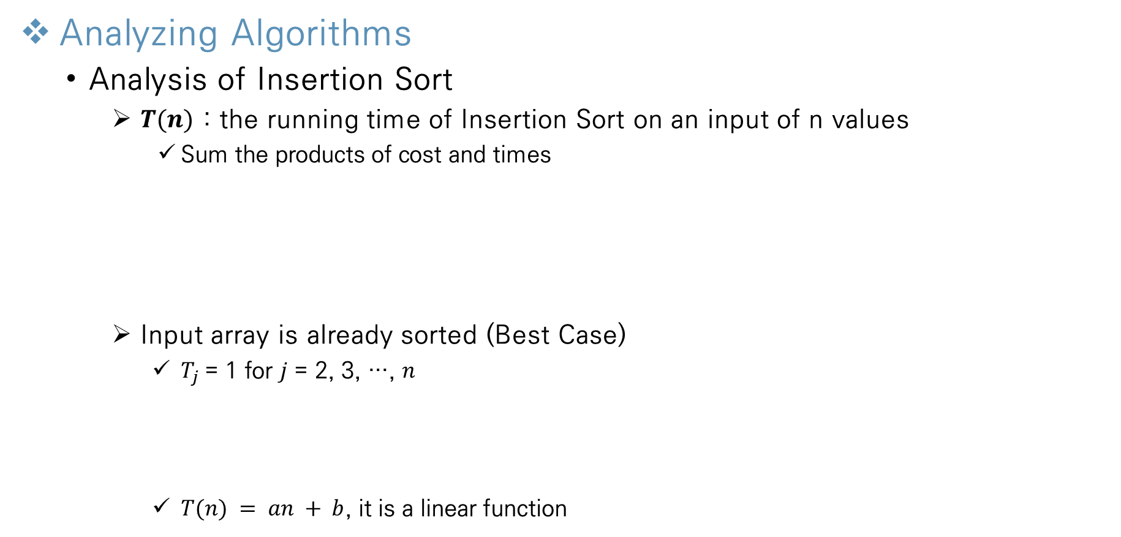
Getting Started
Analyzing Algorithms
Analysis of Insertion Sort
$T(n)$ : the running time of Insertion Sort on an input of n values
Sum the products of cost and times
m
Input array is already sorted (Best Case)
$T_{j}$= 1 for $j$ = 2, 3, …, $n$
$T(n) = an + b$, it is a linear function
Notes:
모든 Feature마다 이상치를 제거하게 되면 너무 많은 데이터 손실이 발생

Slide 10
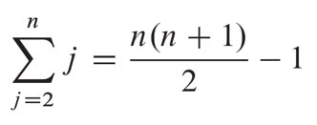
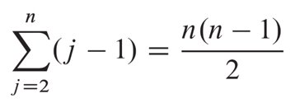
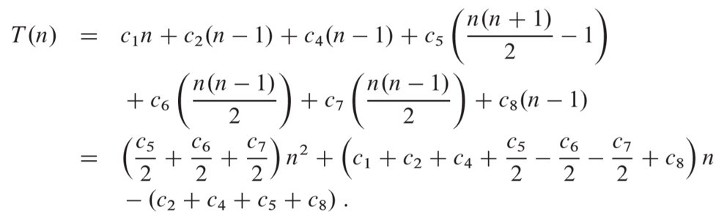
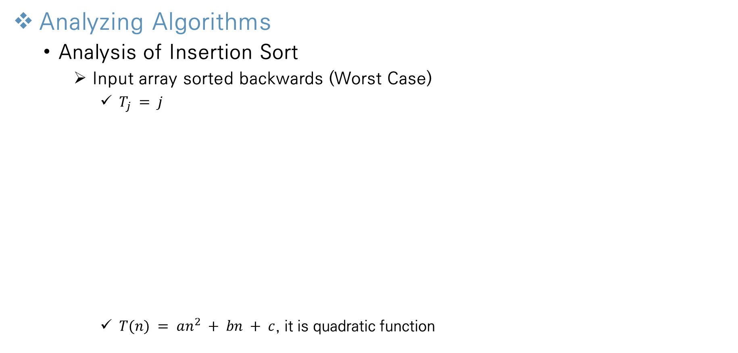
Getting Started
Analyzing Algorithms
Analysis of Insertion Sort
Input array sorted backwards (Worst Case)
$T_{j} = j$
$T(n) = an^{2} + bn + c$, it is quadratic function
Notes:
모든 Feature마다 이상치를 제거하게 되면 너무 많은 데이터 손실이 발생

Slide 11
Getting Started
Analyzing Algorithms
Worst–case & Average–case analysis
Concentrate on finding only the worst-case running time
The worst-case running time of an algorithm gives us an upper bound on the running time for any input
Provides a guarantee that the algorithm will never take any longer
For some algorithms, the worst case occurs fairly often
Searching a database for information when the information is not present in database
The "average case" is often roughly as bad as the worst case
Half of the elements in A[1..j-1] are less than A[j] (key value)
Tj = j/2 -> average-case running time is quadratic function
Notes:
모든 Feature마다 이상치를 제거하게 되면 너무 많은 데이터 손실이 발생

Slide 12
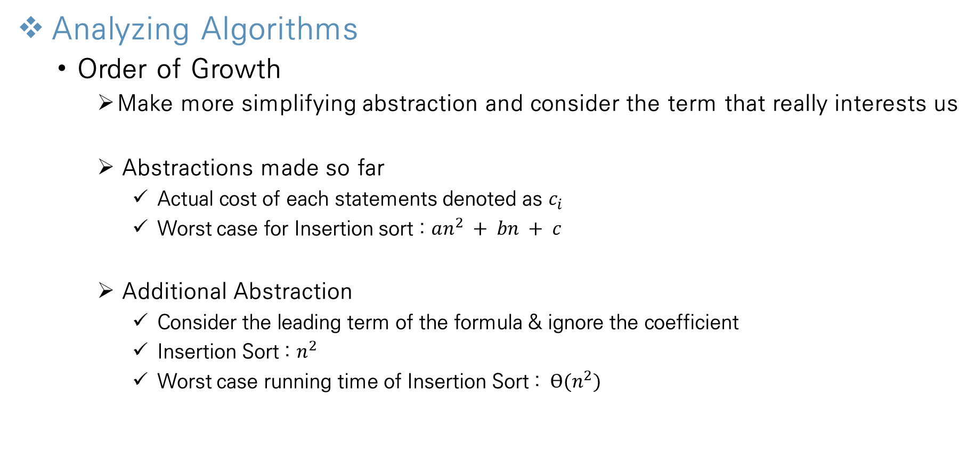
Getting Started
Analyzing Algorithms
Order of Growth
Make more simplifying abstraction and consider the term that really interests us
Abstractions made so far
Actual cost of each statements denoted as $c_{i}$
Worst case for Insertion sort : $an^{2} + bn + c$
Additional Abstraction
Consider the leading term of the formula & ignore the coefficient
Insertion Sort : $n^{2}$
Worst case running time of Insertion Sort : $ϴ(n^{2})$
Notes:
모든 Feature마다 이상치를 제거하게 되면 너무 많은 데이터 손실이 발생

Slide 13
Getting Started
Designing Algorithms
Divide and Conquer Approach
Definition : break the problem into several subproblems that are similar to the original problem, solve the subproblems recursively, and combine these solutions to create a solution to the orignal problem
Steps
Divide : Divide the problem into a number of subproblems that are smaller instances of the same problem
Conquer : Conquer the subproblems by solving them recursively. If subproblem sizes are small enough, just solve them
Combine : Combine the solutions to the subproblems into the solution for the original problem
Notes:
모든 Feature마다 이상치를 제거하게 되면 너무 많은 데이터 손실이 발생

Slide 14
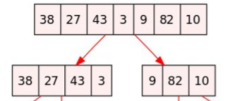
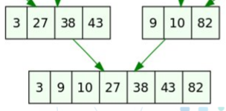
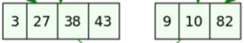
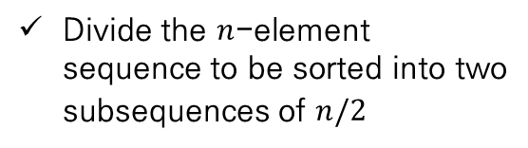
Getting Started
Designing Algorithms
Divide-and-conquer approach of Merge Sort
Divide
Conquer
Combine
Divide the $n$-element sequence to be sorted into two subsequences of $n/2$
Sort the two subsequences recursively using merge sort
Merge the two sorted subsequences to produce the sorted answer
Notes:
모든 Feature마다 이상치를 제거하게 되면 너무 많은 데이터 손실이 발생

Slide 15
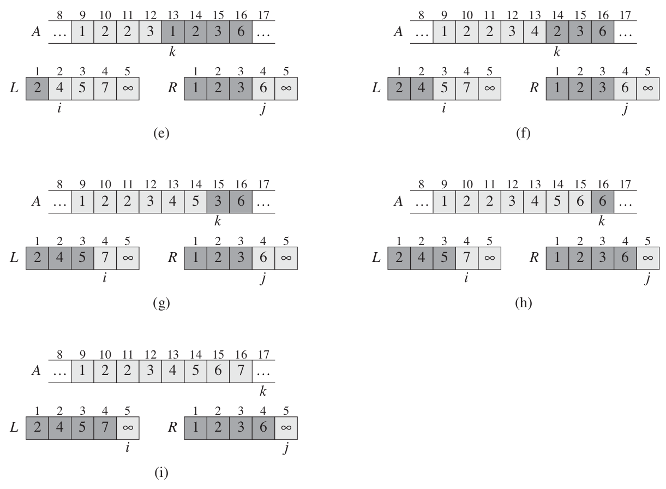
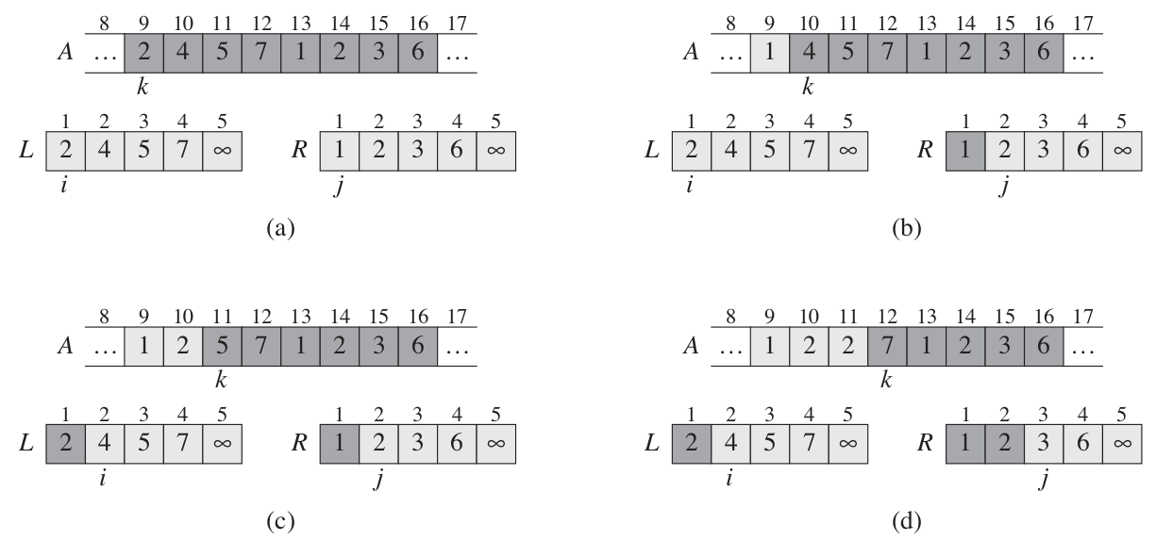
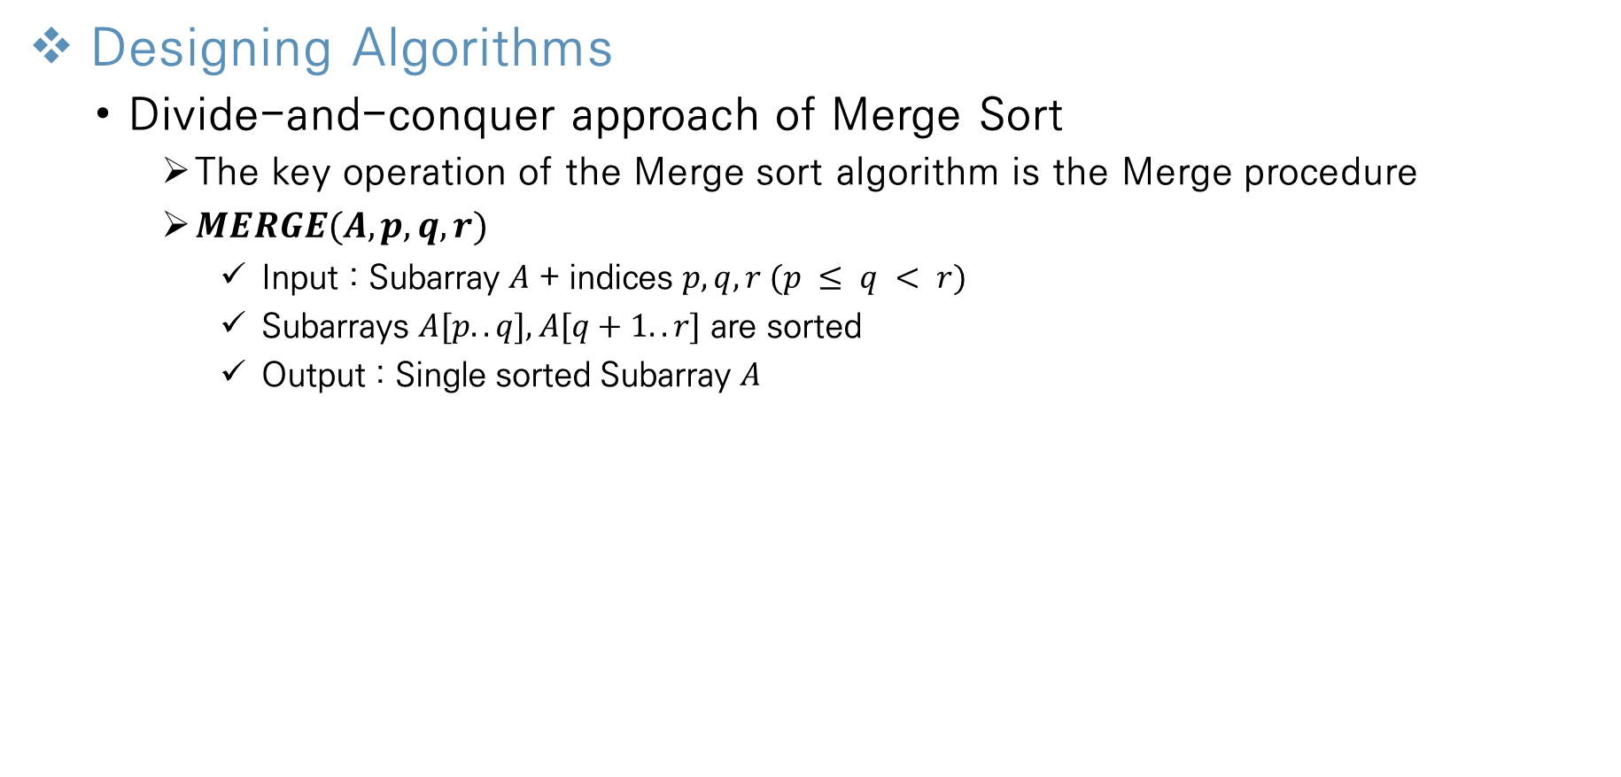
Getting Started
Designing Algorithms
Divide-and-conquer approach of Merge Sort
The key operation of the Merge sort algorithm is the Merge procedure
$MERGE(A, p, q, r)$
Input : Subarray $A$ + indices $p, q, r (p ≤ q < r)$
Subarrays $A[p..q], A[q+1..r]$ are sorted
Output : Single sorted Subarray $A$
Notes:
모든 Feature마다 이상치를 제거하게 되면 너무 많은 데이터 손실이 발생

Slide 16
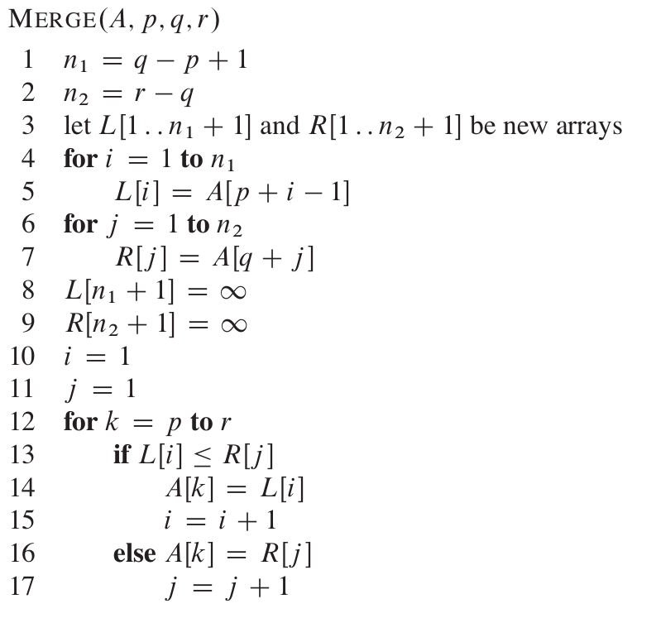
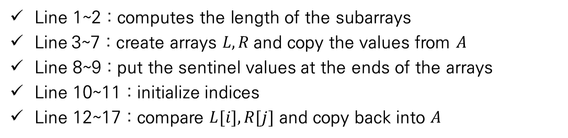
Getting Started
Designing Algorithms
Divide-and-conquer approach of Merge Sort
Line 1~2 : computes the length of the subarrays
Line 3~7 : create arrays $L, R$and copy the values from $A$
Line 8~9 : put the sentinel values at the ends of the arrays
Line 10~11 : initialize indices
Line 12~17 : compare $L[i], R[j]$ and copy back into $A$
→ $MERGE(A, p, q, r)$takes $ϴ(n) times$
Notes:
모든 Feature마다 이상치를 제거하게 되면 너무 많은 데이터 손실이 발생

Slide 17
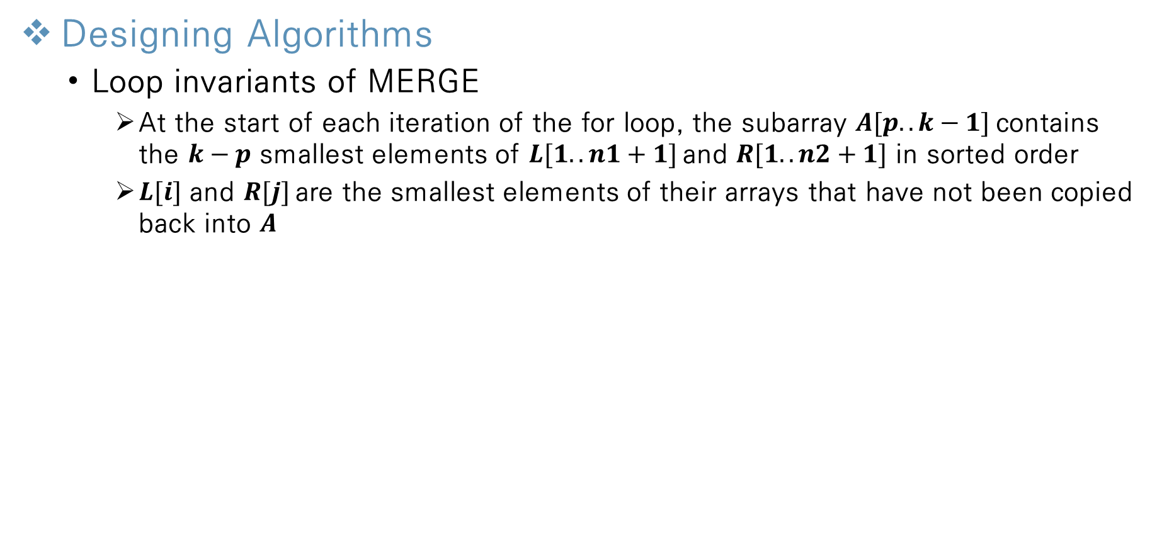
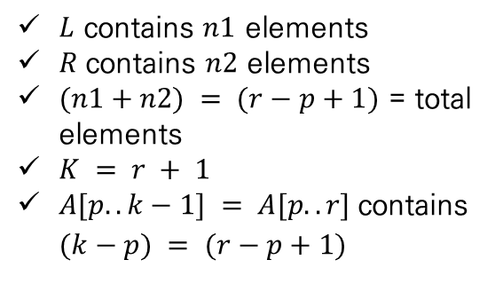
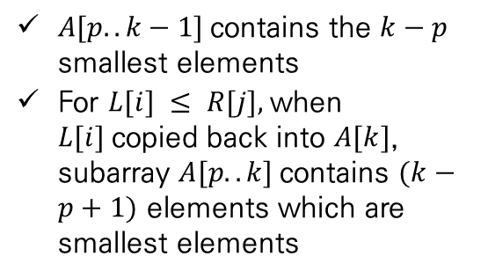
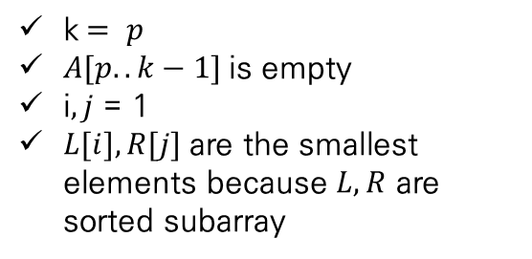
Getting Started
Designing Algorithms
Loop invariants of MERGE
At the start of each iteration of the for loop, the subarray $A[p..k−1]$contains the $k−p$ smallest elements of $L[1..n1+1]$and $R[1..n2+1]$ in sorted order
$L[i]$ and $R[j]$are the smallest elements of their arrays that have not been copied back into $A$
Initialization
Maintenance
Termination
k$= p$
$A[p..k−1]$is empty
i$,j$ = 1
$L[i], R[j]$are the smallest elements because $L, R$ are sorted subarray
$A[p..k−1]$contains the $k−p$ smallest elements
For $L[i] ≤ R[j],$when $L[i]$copied back into $A[k]$, subarray $A[p..k]$contains $(k−p+1)$ elements which are smallest elements
$L$ contains $n1$ elements
$R$contains $n2$ elements
$(n1+n2) = (r−p+1)$ = total elements
$K = r + 1$
$A[p..k−1] = A[p..r]$contains $(k−p) = (r−p+1)$
Notes:
모든 Feature마다 이상치를 제거하게 되면 너무 많은 데이터 손실이 발생

Slide 18
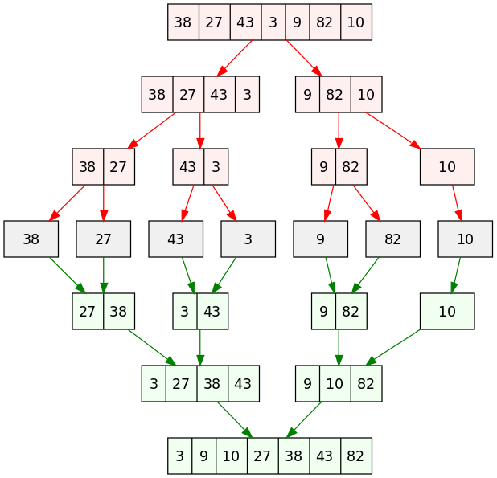
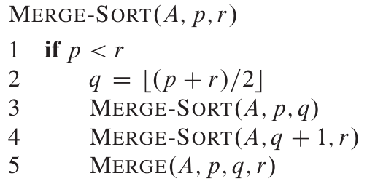
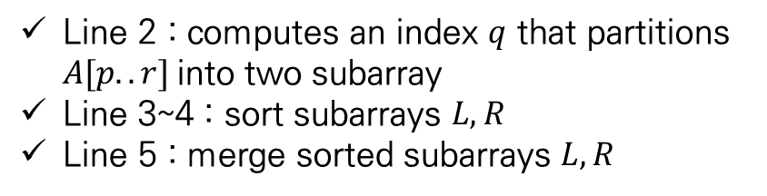
Getting Started
Designing Algorithms
Merge Sort
MERGE-SORT(A, p, r)
Line 2 : computes an index $q$ that partitions $A[p..r]$into two subarray
Line 3~4 : sort subarrays $L, R$
Line 5 : merge sorted subarrays $L, R$
Notes:
모든 Feature마다 이상치를 제거하게 되면 너무 많은 데이터 손실이 발생

Slide 19
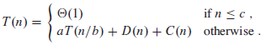
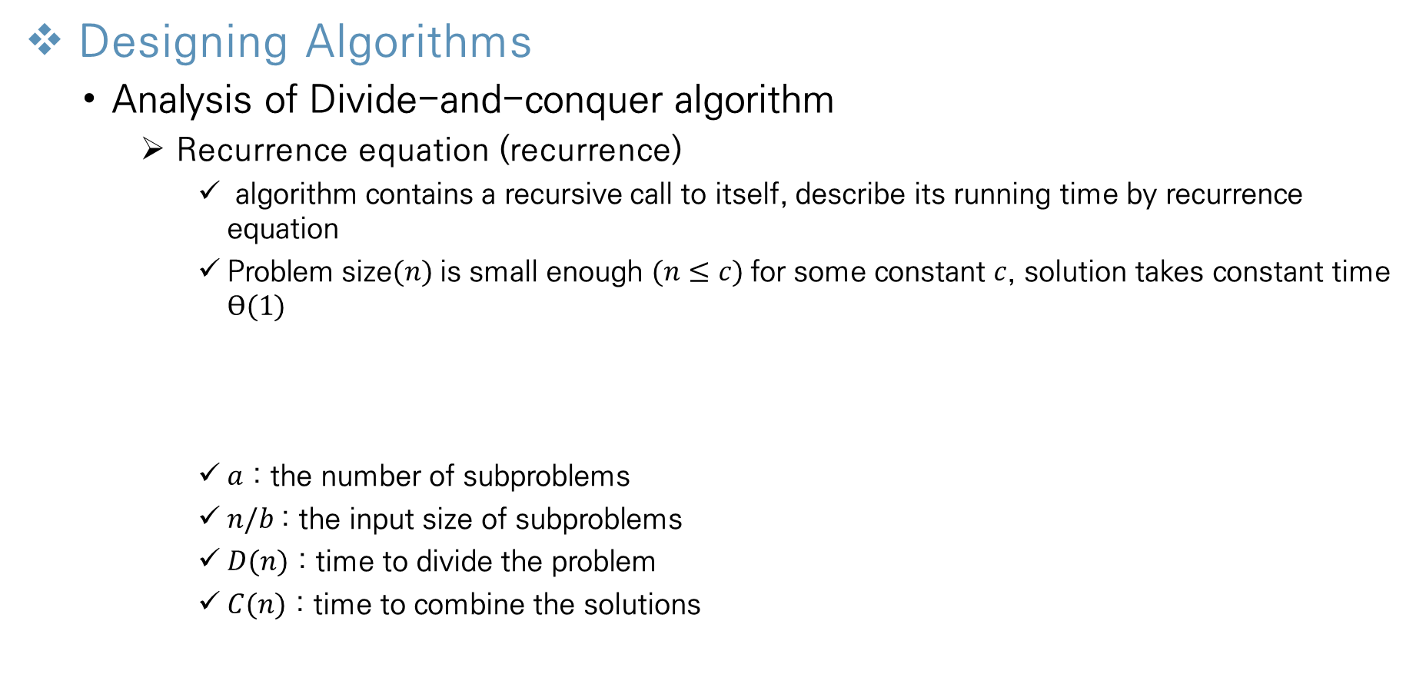
Getting Started
Designing Algorithms
Analysis of Divide-and-conquer algorithm
Recurrence equation (recurrence)
algorithm contains a recursive call to itself, describe its running time by recurrence equation
Problem size$(n)$is small enough $(n≤c)$for some constant $c$, solution takes constant time $ϴ(1)$
$a$ : the number of subproblems
$n/b$: the input size of subproblems
$D(n)$ : time to divide the problem
$C(n)$ : time to combine the solutions
Notes:
모든 Feature마다 이상치를 제거하게 되면 너무 많은 데이터 손실이 발생

Slide 20
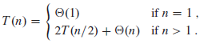
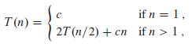
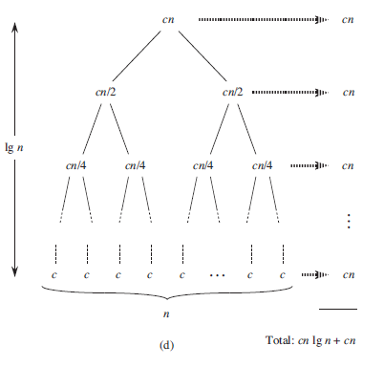
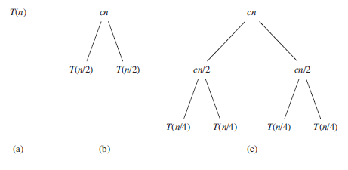
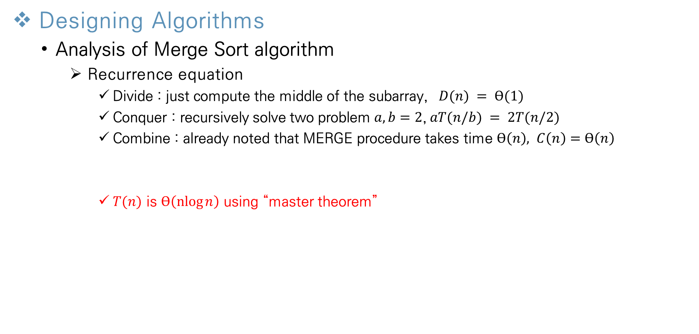
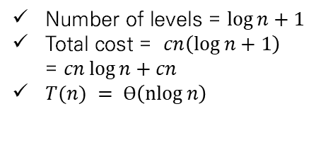
Getting Started
Designing Algorithms
Analysis of Merge Sort algorithm
Recurrence equation
Divide : just compute the middle of the subarray, $D(n) = ϴ(1)$
Conquer : recursively solve two problem $a, b=2$,$aT(n/b) = 2T(n/2)$
Combine : already noted that MERGE procedure takes time $ϴ\left(n\right), C\left(n\right)=ϴ\left(n\right)$
$T(n)$ is $ϴ\left(\operatorname{nlog}{n}\right)$ using “master theorem”
Number of levels = $\log{n}+1$
Total cost = $cn\left(\log{n}+1\right)$ = $cn\log{n}+cn$
$T(n) = ϴ\left(\operatorname{nlog}{n}\right)$
Notes:
모든 Feature마다 이상치를 제거하게 되면 너무 많은 데이터 손실이 발생

Slide 21
Thank You!

